Slide 1
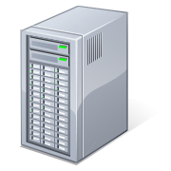



SQL BI Manager, How it Works
Architecture
SQL BI Mgr. Collection Service
BI Manager Machine
SSAS
Tomcat Web Service
SSIS
BI Manager Repository
(history)
Web Based User Console
(Distributed)
SSAS

